Slide 1
Counterfactual Identifiability of Bijective Causal Models
Arash Nasr-Esfahany, Mohammad Alizadeh, Devavrat Shah

Slide 2
Ladder of Causation
Counterfactuals
$L_{3}:$ Imagining
$L_{2}:$ Doing
$L_{1}:$ Seeing
Interventions
Associations

Slide 3
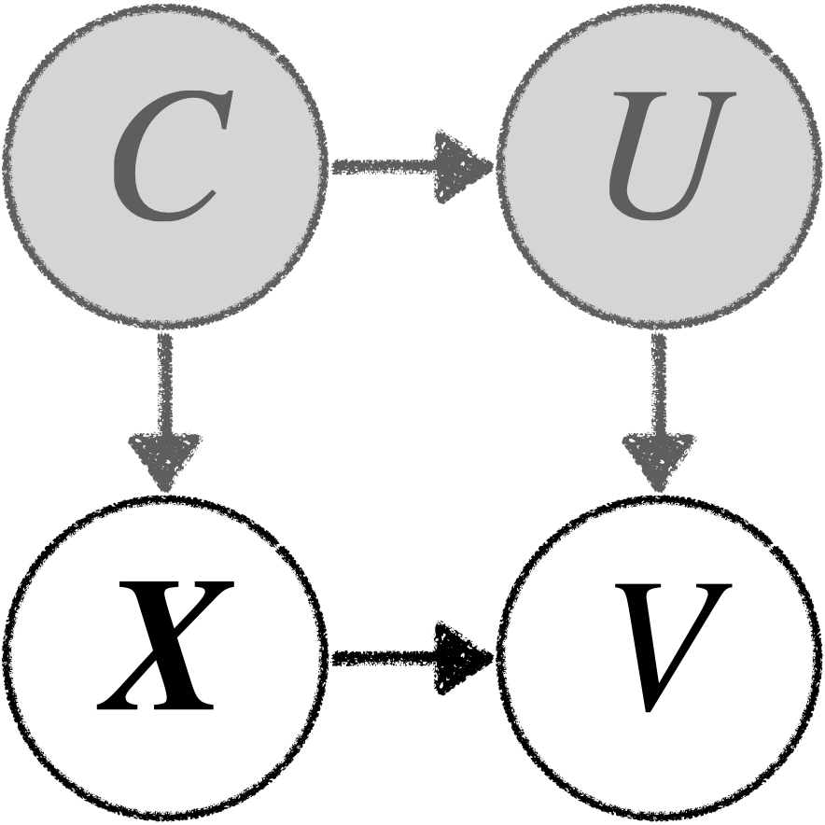
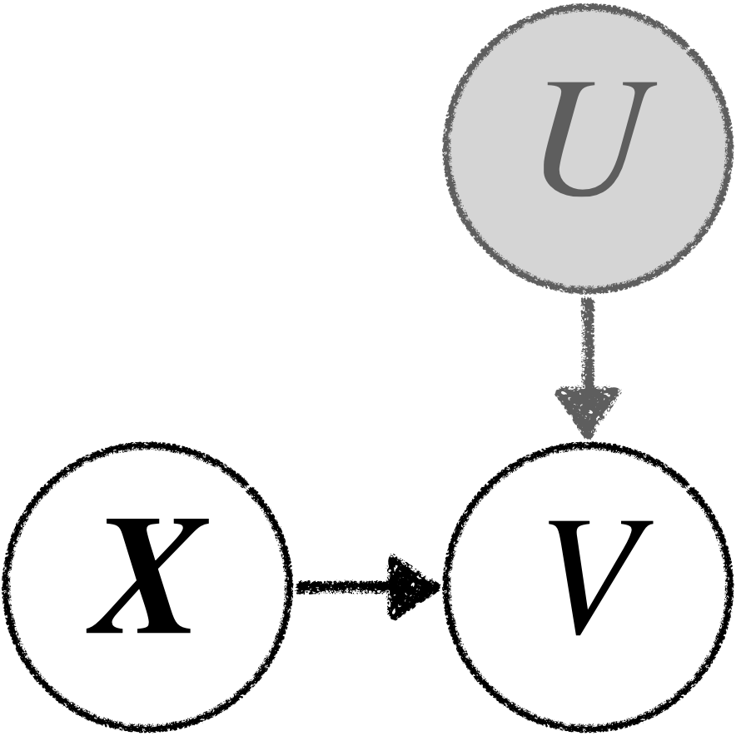
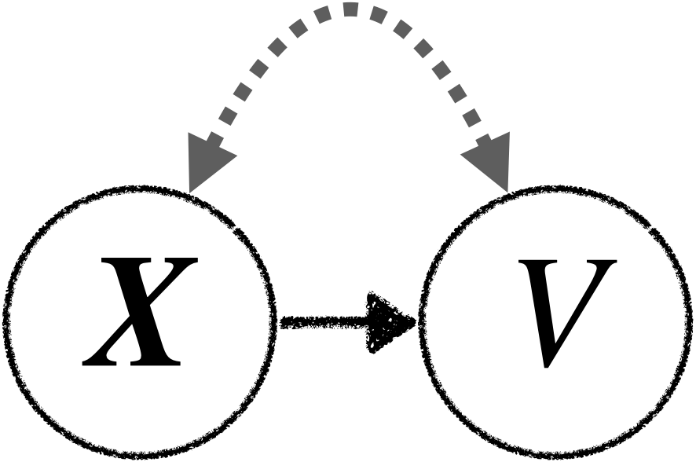
Background: Causal Models
Causal DAG
Structural Causal Model
Exogenous Noise
$$V=f\left(X,U\right)$$
Causal Parents

Slide 4
Bijective Causal Models
Consist of Bijective Generation Mechanism (BGM)
Subsumes several causal models studied in the literature:
Nonlinear Additive Noise models (ANM) [Hoyer et. al., NeurIPS 2008]
Location Scale Noise models (LSNM) [Immer et. al., ICML 2023]
Post Nonlinear Causal Model (PNL) [Zhang et. al., UAI 2009]
BGM Definition
$∀x: f\left(x, ⋅\right)$ is a bijection. $→∀x:{ v=f}^{−1}\left(x,u\right)$.

Slide 5
Counterfactual Identifiability of BGMs
$$\underset{→}{?}$$
$$f(⋅,⋅)$$
$${x_{i},v_{i}\sim P}_{X, V}$$
Observational Data

Slide 6
Identifiability Theorem: The Backdoor Criterion (BC)
$V=f\left(X,U\right)$
$U⫫X$

Slide 7
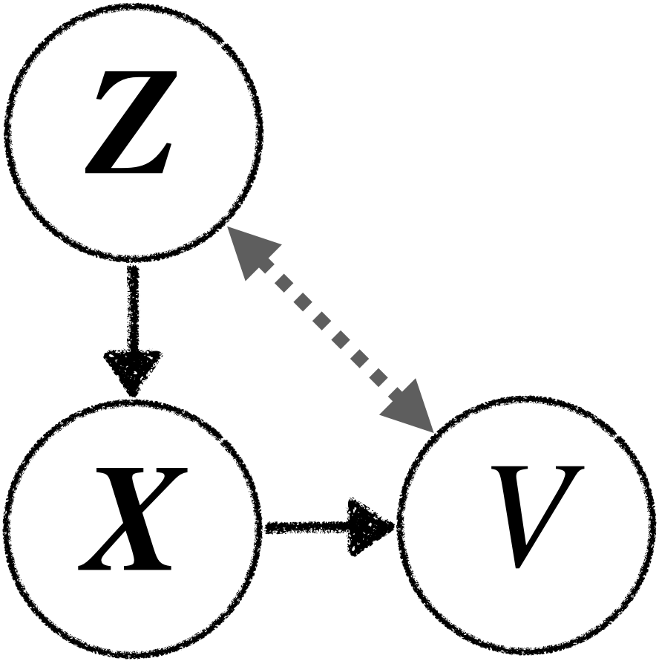
Identifiability Theorem: The Backdoor Criterion (BC)
$U⫫X|Z$
$U,V∈ℝ^{d}$.
X and Z can be discrete or continuous.
Identifiable from $P_{X, V, Z}$ if:
$∀x: ∇_{x}\left|\det{J_{f\left(x, ⋅\right)}}\right|$ and $∇_{x}\left|\det{J_{f^{−1}\left(x, ⋅\right)}}\right|$ exist.
(Variability) $∃\left\{z_{1},…,z_{d+1}\right\}:P_{U|Z }(⋅|z_{i})$ are distinct.
Please see the paper for precise definition of this condition.

Slide 8
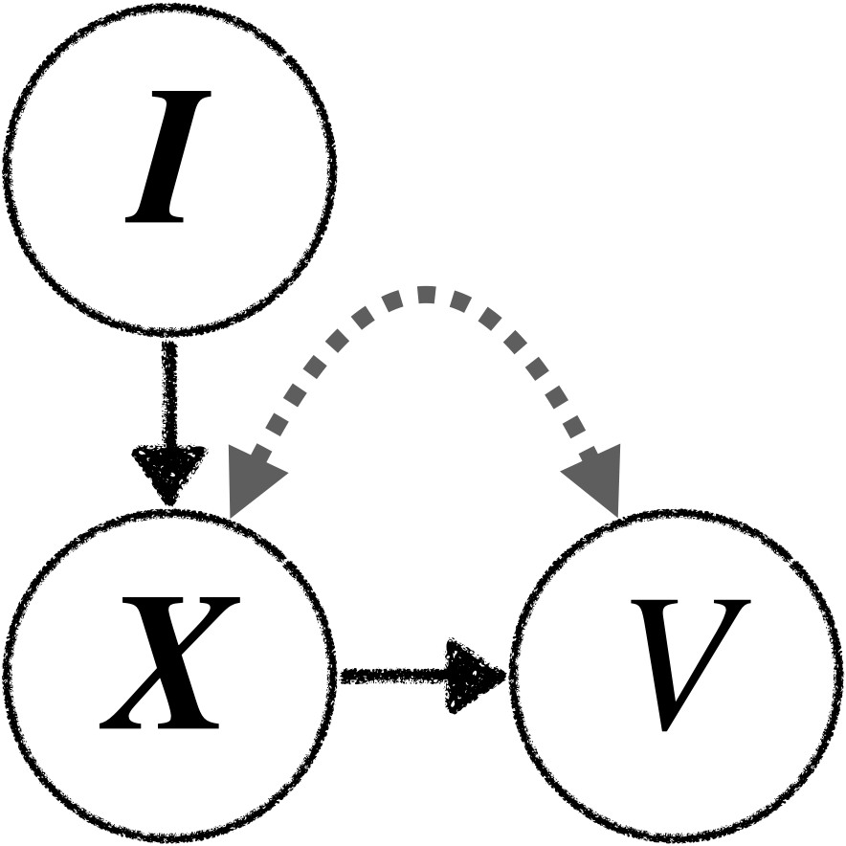
Other Identifiability Theorems
The Markovian Case
Instrumental Variable (IV)

Slide 9
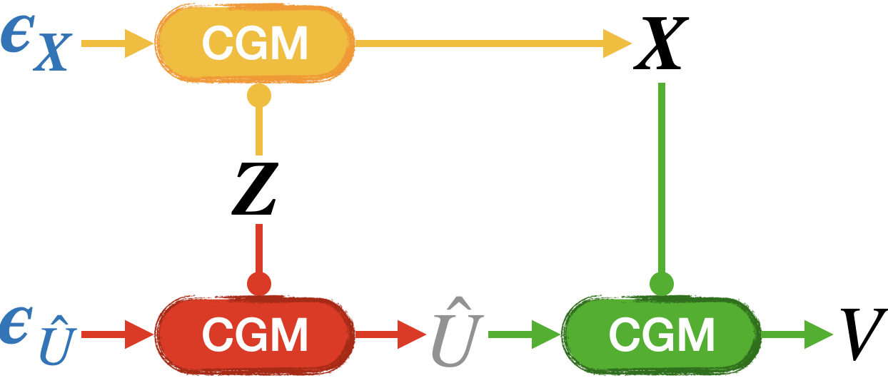
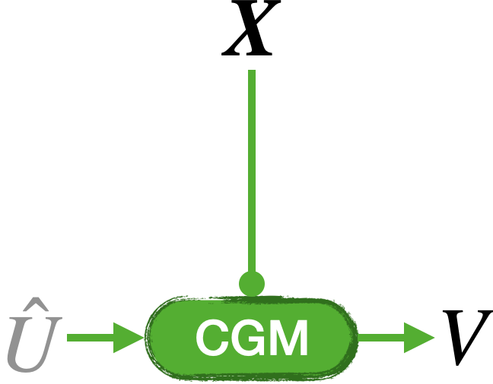
Practical Algorithm
$U⫫X|Z$
BC
Conditional Generative Model

Slide 10
Video Streaming Simulation
CausalSim: A Causal Framework for Unbiased Trace-Driven Simulation [Alomar et. al., NSDI 2023]

Slide 11
Contributions
Introduced Bijective Causal Models.
Established their counterfactual identifiability in three well-known causal structures.
Proposed a practical method for learning them.
bgm.csail.mit.edu

